Slide 1



COMP
1521
WEEK 7!

Slide 2

CONTENT
01
2'S COMPLIMENT
02
FLOATING POINT NUMBERS

Slide 3
Negative Numbers
to write -x in n bits of data:
binary = 2 -X
n

Slide 4
2's complement
n
The result of 2 -X is identical to an operation called 2's complement.
0000 0101 = 5
1111 1011 =-5
=2^8 - 5 = 251

Slide 5
2's complement
n
The result of 2 -X is identical to an operation called 2's complement.
0000 0101 = 5
1111 1011 =-5
=2^8 - 5 = 251
translation:
the negative of a number is just the 2's complement!

Slide 6
2's complement
n
The result of 2 -X is identical to an operation called 2's complement.
0000 0101 = 5
1111 1011 =-5
=2^8 - 5 = 251
To do 2's compliment:

Slide 7
2's complement
n
The result of 2 -X is identical to an operation called 2's complement.
0000 0101 = 5
1111 1011 =-5
=2^8 - 5 = 251
To do 2's compliment:
take the ‘not’ of the binary
0000 0101
1111 1010
invert, or ‘not’

Slide 8
2's complement
n
The result of 2 -X is identical to an operation called 2's complement.
0000 0101 = 5
1111 1011 =-5
=2^8 - 5 = 251
To do 2's compliment:
take the ‘not’ of the binary
0000 0101
1111 1010
invert, or ‘not’
<- this is known as the 1’s compliment!
2. add 1 to the number
1111 1010
1111 1011
+1

Slide 9
Taking 2's compliment is much faster than
calculating 2 -X for larger n’s!
n
it is equivalent to *-1

Slide 10
Q1 iii, iv, v
Q2 ii, v, vi, vii

Slide 11

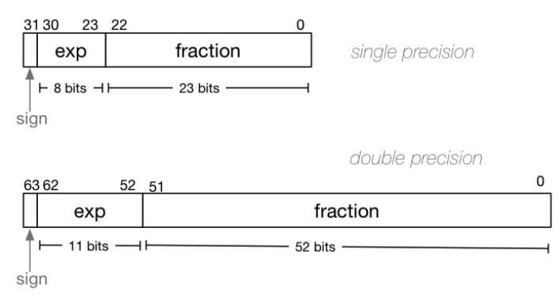
Floats (decimals)
also known as IEEE 754 standard or IEEE 754-1985
IEEE 754 single -> float
IEEE 754 double -> double

Slide 12
Floats (decimals)
Overall Formula:
(-1) *
sign
exp - 127
(1.frac) * 2

Slide 13
Floats (decimals)
Sign
The sign is the easiest .
0 -> positive number
1 -> negative number
c
Overall Formula:
(-1) *
sign
exp - 127
(1.frac) * 2

Slide 14





Floats (decimals)
Sign
The sign is the easiest .
0 -> positive number
1 -> negative number
c
Overall Formula:
(-1) *
sign
exp - 127
(1.frac) * 2
sign = 0 ⇒ (-1)^0 = 1（positive）
sign = 1 ⇒ (-1)^1 = -1（negative）

Slide 15
Floats (decimals)
Sign
The sign is the easiest .
0 -> positive number
1 -> negative number
2. exponent
exp has a bias of -127 added to it
2
Overall Formula:
exp - 127
(-1) *
sign
exp - 127
(1.frac) * 2

Slide 16
Floats (decimals)
Sign
The sign is the easiest .
0 -> positive number
1 -> negative number
2. exponent
exp has a bias of -127 added to it
2
Overall Formula:
exp - 127
(-1) *
sign
exp - 127
(1.frac) * 2
Exp is an 8-bit unsigned integer
The raw exponent field (exp) ranges from 0 to 255.
The actual exponent (e = exp - 127) would mathematically range from: -127 to 128

Slide 17
Floats (decimals)
Sign
The sign is the easiest .
0 -> positive number
1 -> negative number
2. exponent
exp has a bias of -127 added to it
2
exp - 127
Overall Formula:
3. fraction
the fraction is concatenated to the end of 1
e.g. for a fraction of “0101 1010”,
1.frac means 1.0101 1010 (binary decimal)
(-1) *
sign
exp - 127
(1.frac) * 2

Slide 18

Floats (decimals)
Sign
The sign is the easiest .
0 -> positive number
1 -> negative number
2. exponent
exp has a bias of -127 added to it
2
exp - 127
Overall Formula:
3. fraction
the fraction is concatenated to the end of 1
e.g. for a fraction of “0101 1010”,
1.frac means 1.0101 1010 (binary decimal)
(-1) *
sign
exp - 127
(1.frac) * 2
1.101 is

Slide 19
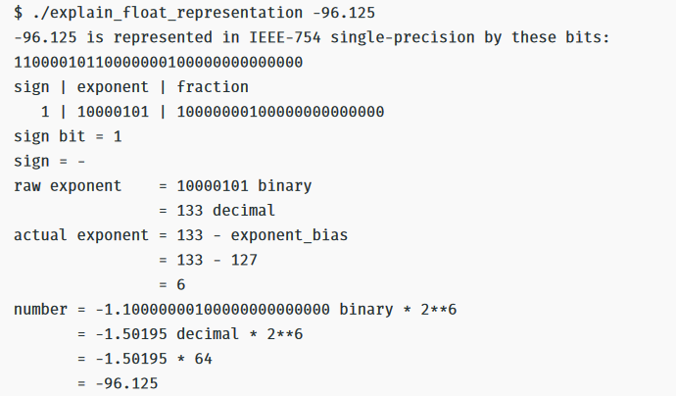
Floats (decimals)
Overall Formula:
(-1) *
sign
exp - 127
(1.frac) * 2

Slide 20
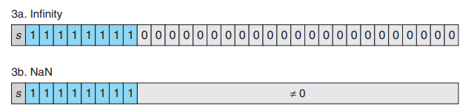
Floats (decimals)
Special Cases:
NaN = Not a Number, such as when you try to divide by 0.
+ and - inf are both defined! (so pay attention to the sign)
NaN is usually not defined as + or -

Slide 21
Floats (decimals)
Special Cases:
NaN = Not a Number, such as when you try to divide by 0.
+ and - inf are both defined! (so pay attention to the sign)
NaN is usually not defined as + or -
The trick is to always check if the exp bits >= 0xFF!

Slide 22
q4 a->f

Slide 23
working backwards
how to make a number K into float form?

Slide 24
q5
Labs - extract the components of a float

